Slide 1
Romans 8:12-18

Slide 2
¹² So then, brothers, we are debtors, not to the flesh, to live according to the flesh. ¹³ For if you live according to the flesh you will die, but if by the Spirit you put to death the deeds of the body, you will live. ¹⁴ For all who are led by the Spirit of God are sons of God. ¹⁵ For you did not receive the spirit of slavery to fall back into fear, but you have received the Spirit of adoption as sons, by whom we cry, “Abba! Father!”

Slide 3
¹⁶ The Spirit himself bears witness with our spirit that we are children of God, ¹⁷ and if children, then heirs—heirs of God and fellow heirs with Christ, provided we suffer with him in order that we may also be glorified with him.
¹⁸ For I consider that the sufferings of this present time are not worth comparing with the glory that is to be revealed to us.

Slide 4
Walking according to the Spirit Vs according to the flesh
The things of God are life and peace
Hostility towards God
The defining mark of a Christian (of being saved) is to be filled with Christ
To have Christ in our heart, assures us “We are sons of God”
^{Romans 8:15} ... you have received the Spirit of adoption as sons, by whom we cry, “Abba! Father!”

Slide 5
Isaiah 42:8 (ESV)
⁸ I am the Lord (YHWH); that is my name;
my glory I give to no other,
nor my praise to carved idols.
Exodus 3:15 (ESV)
¹⁵ God also said to Moses, “Say this to the people of Israel, ‘The Lord (YHWH), the God of your fathers, the God of Abraham, the God of Isaac, and the God of Jacob, has sent me to you.’ This is my name forever, and thus I am to be remembered throughout all generations.

Slide 6
Walking according to the Spirit Vs according to the flesh
The things of God are life and peace
Hostility towards God
The defining mark of a Christian (of being saved) is to be filled with Christ
To have Christ in our heart, assures us “We are sons of God”
^{Romans 8:15} ... you have received the Spirit of adoption as sons, by whom we cry, “Abba! Father!”
Not forced into brutal slavery to Christ.
We willingly follow the Father’s footsteps, because we are heirs.
His business is our business
We fear God with a healthy respect.
But we’re not scared of Him – we are in Christ and Christ is in us.
Suffering – one of the marks of being a Christian

Slide 7
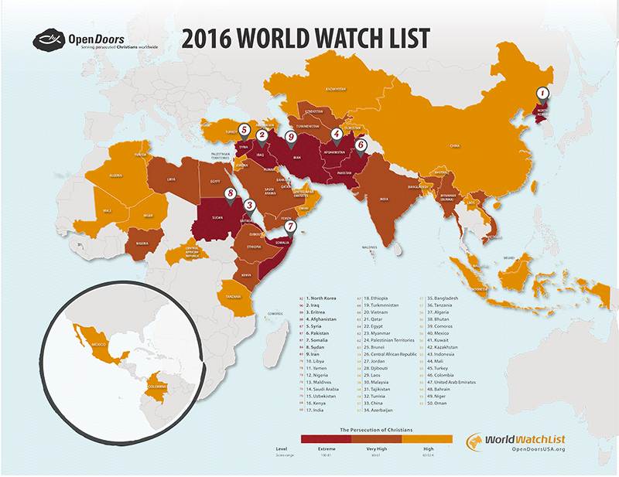

Slide 8
Walking according to the Spirit Vs according to the flesh
The things of God are life and peace
Hostility towards God
The defining mark of a Christian (of being saved) is to be filled with Christ
To have Christ in our heart, assures us “We are sons of God”
^{Romans 8:15} ... you have received the Spirit of adoption as sons, by whom we cry, “Abba! Father!”
Not forced into brutal slavery to Christ.
We willingly follow the Father’s footsteps, because we are heirs.
His business is our business
We fear God with a healthy respect.
But we’re not scared of Him – we are in Christ and Christ is in us.
Suffering – one of the marks of being a Christian
To suffer for Christ, is to suffer with Christ
An assurance – we will be glorified in Christ

